Slide 1
Round-Trip Flight Data Analysis

Slide 2
Outline
This presentation covers the results of the analysis of the flight data.
The following results are presented:
Busiest round-trip routes
Most profitable round-trip routes
Recommended round-trip routes for investment
Number of round-trip flights to break even for recommended routes
key Performance Indicators (KPI’s) to track for recommended routes

Slide 3
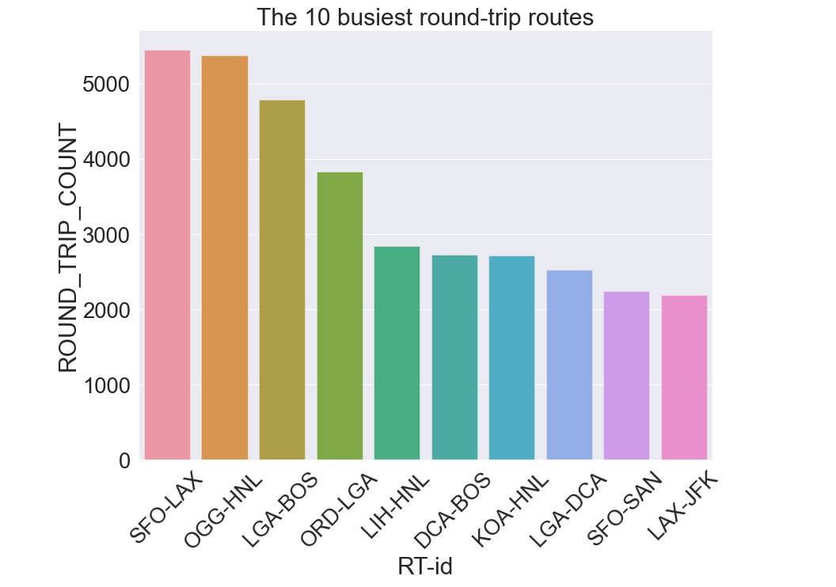
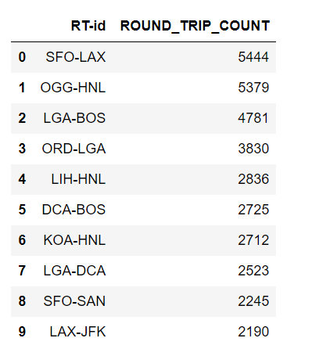
Busiest Round-Trip Routes

Slide 4
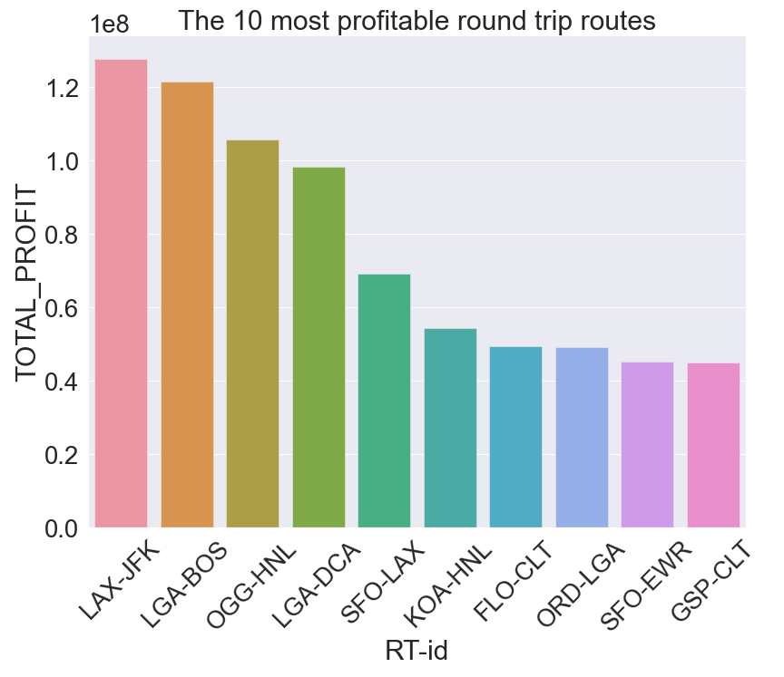
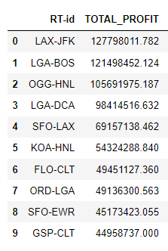
Most Profitable Round-Trip Routes

Slide 5
Recommended Round-Trip Routes for Investment
Based on the wide gap in profit margin between these trips and others
I recommend that the company invest in:
LAX-JFK (Los Angeles International Airport - John F Kennedy International Airport)
LGA-BOS (La Guardia Airport - General Edward Lawrence Logan International Airport)
OGG-HNL (Kahului Airport - Daniel K Inouye International Airport)
LGA-DCA (La Guardia Airport - Ronald Reagan Washington National Airport)
SFO-LAX (San Francisco International Airport - Los Angeles International Airport)

Slide 6
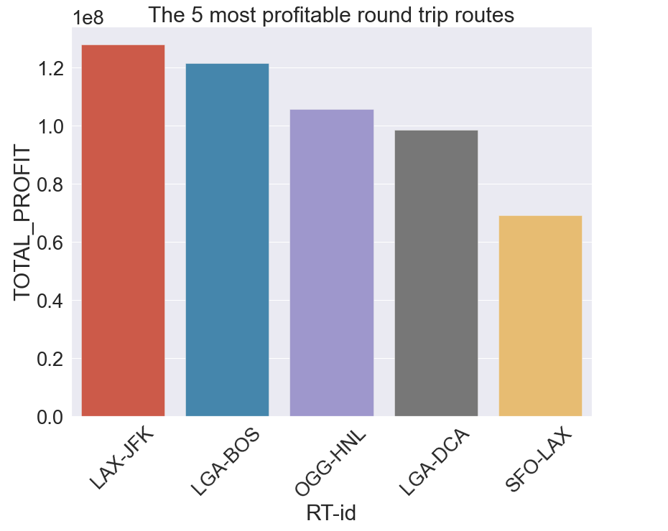
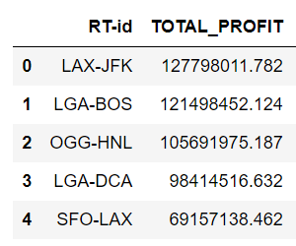
Recommended Round-Trip Routes for Investment

Slide 7
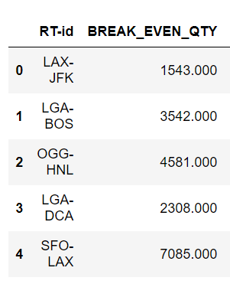
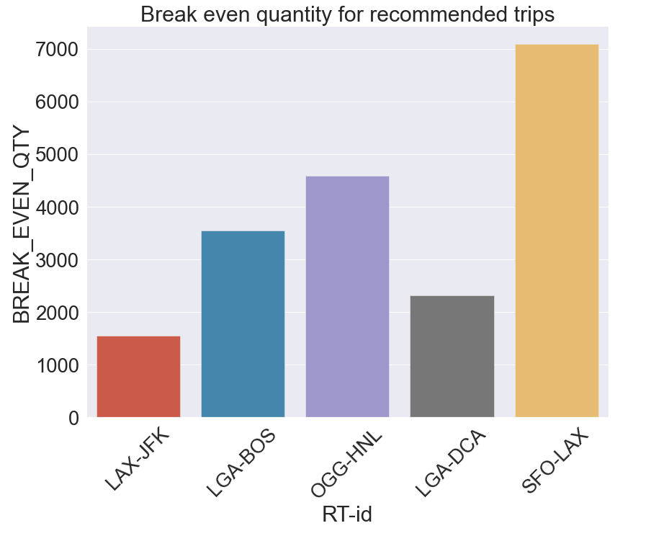
Break Even Analysis

Slide 8
Key Performance Indicators (KPI’s) to Track
From the analysis carried it was seen that these parameters help to determine the overall cost and revenue and then profit associated with a route.
Number of round trips
Average occupation rate per flight
Average cost of ticket for different airlines
Average penalizable initial departure delay
Average penalizable initial arrival delay
Average penalizable final departure delay
Average penalizable final arrival delay
Revenue per flight
Cost per flight
Profit per flight
Total revenue
Total cost
Total profit

Slide 9
CONCLUSION
From this analysis adequate information has been provided to recommend round trip routes to invest in.
This information should help guide the decision-making process of relevant stakeholders.

